Slide 1

THE STUDY OF TRADITIONAL AND NON TRADITIONAL FUELS IN INDIA
P.E.S’S
MODERN COLLEGE OF ARTS,
SCIENCE & COMMERCE
SHIVAJINAGAR PUNE-5

Slide 2
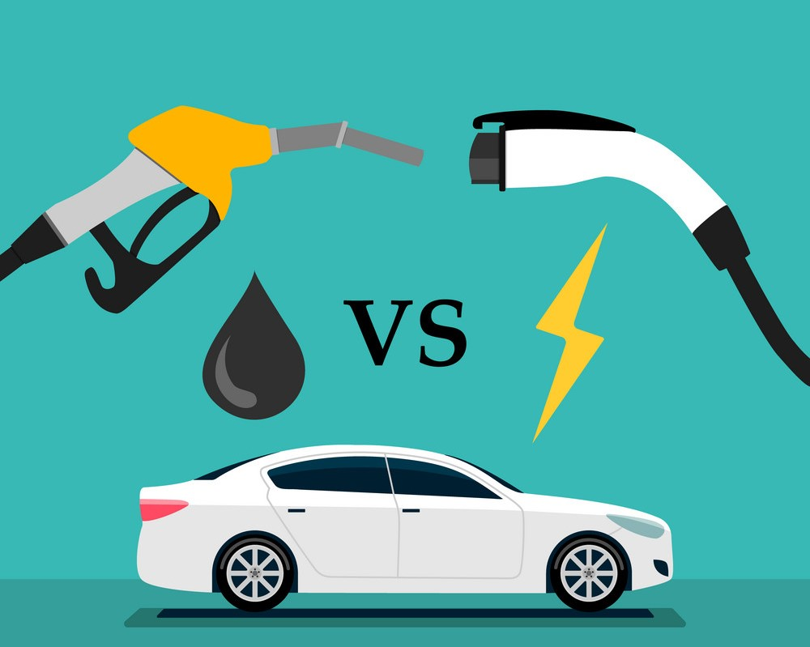
MSc – STATISTICS PROJECT
Ishwari . R . Sarde
Bhakti . A Jadhav
Sahil . M . Sathe
Guide : Prof . Dr. Manisha Sane
Head of Department of Statistics
PES Modern College of Arts , Science and
Commerce.

Slide 3
INTRODUCTION
The fossil Fuel price is increasing & its impact of its carbon emission on environment have called for change in individual transportation habit.
Electric vehicles was the only outstanding solution to all the major arising problems in environment .
Though, sector is gravitating towards Non-Traditional fuels there is also need to study Traditional fuels
Traditional fuels may be not get highly affected by Non-Traditional Fuels so easily.
The large amount of data when studied properly and analysed carefully can be used in many future predictions and may help to avoid loss over period of time.
We selected this project to get glimpse of many problems related to environment.
We can study future values of all fuels and take voluntary actions to increase the count of vehicles running on Non Traditional fuels.

Slide 4
OBJECTIVES
1) Check which Vehicle Category is mostly used and which Fuel is mostly used in it.
2) To observe growth of Traditional fuels & Non Traditional fuels in India.
3) To do comparable study of EV and other fuels like CNG, Petrol, Diesel, LPG for India.
4) To analyse in which States of India we need to spread awareness of Electric Vehicles.
5) To study the increase in count of Traditional & Non-Traditional fuels in next 3-4 years in India.

Slide 5
Data Source (Link) : https://vahan.parivahan.gov.in/vahan4dashboard/vahan/dashboardview.xhtml;jsessionid=4C3A86ADE94A8F88702116553FB2A13F KEYWORDS FORECASTING Exploratory Data Analysis Time Series Analysis Correspondence Analysis

Slide 6
CATEGORY WISE ANALYSIS OF FUELS
VEHICLE CATEGORY | DIESEL COUNT
HEAVY VEHICLE | 4560791
MEDIUM VEHICLE | 930292
LIGHT VEHICLE | 27000595
3 WHEELER | 3920193
2 WHEELER | 78732
VEHICLE CATEGORY | PETROL COUNT
HEAVY VEHICLE | 5298
MEDIUM VEHICLE | 2192
LIGHT VEHICLE | 18173864
3 WHEELER | 703054
2 WHEELER | 179630386

Slide 7
VEHICLE CATEGORY | CNG COUNT
HEAVY VEHICLE | 48784
MEDIUM VEHICLE | 14683
LIGHT VEHICLE | 152837
3 WHEELER | 176897
2 WHEELER | 355
VEHICLE CATEGORY | EV COUNT
HEAVY VEHICLE | 379
MEDIUM VEHICLE | 90
LIGHT VEHICLE | 16886
3 WHEELER | 246347
2 WHEELER | 65726

Slide 8
HENCE,HIGHLY USED FUELS ARE DIESEL AND PETROL.
VEHICLE CAREGORY | TOTAL | FUEL | EV
HEAVY VEHICLE | 4615307 | DIESEL | 379
LIGHT VEHICLE | 45367587 | DIESEL | 16886
MEDIUM VEHICLE | 947264 | DIESEL | 90
THREE WHEELER | 5100807 | DIESEL | 246347
TWO WHEELER | 179776242 | PETROL | 65726

Slide 9
TIME SERIES ANALYSIS
PETROL :
MODEL:
ARIMA(0,0,1)(0,0,1)[12] with zero mean
Coefficients:
ma1 sma1
0.3853 0.3754
se 0.0634 0.0769
log likelihood = -3168.63
AIC=6343.26 AICC=6343.36 BIC=6353.7

Slide 10
CNG
MODEL :
ARIMA(3,0,1) with zero mean
Coefficients:
ar1 ar2 ar3 ma1 0.0716 -0.2610 -0.6570 0.4839
se
0.1381 0.1017 0.0973 0.1502
sigma^2 = 440572:
log likelihood = -1899.42
AIC=3808.84 AICC=3809.09 BIC=382

Slide 11
DIESEL
MODEL:
ARIMA(2,0,2)(0,0,2)[12] with zero mean
Coefficients:
ar1 ar2 ma1 ma2 sma1 sma2
1.3163 -0.6044 -1.1500 0.1592 0.2772 -0.1443
se 0.1045 0.0888 0.1306 0.1314 0.0707 0.0843
sigma^2 = 254502746:
log likelihood = -2662.56
AIC=5339.12 AICC=5339.6 BIC=5363.48

Slide 12
ELECTRIC VEHICLE
MODEL:
ARIMA(3,1,1)(1,0,0)[12] with drift
Coefficients:
ar1 ar2 ar3 ma1 sar1 drift
0.9926 -0.4887 0.4137 -0.7677 0.6789 1313.631
s.e. 0.1187 0.1083 0.0803 0.1066 0.0901 1536.980
sigma^2 = 5352501: log likelihood = -1312.04
AIC=2638.09 AICc=2638.92 BIC=2658.83

Slide 13
ELECTRIC VEHICLE

Slide 14
EV COUNT WILL BE INCREASE IN FUTURE
COMPARISON BETWEEN EV AND OTHER FUELS

Slide 15
COMPARATIVE STUDY OF EV AND CNG
Parameters | CNG | EV
Emission | Lower emission | zero emission
Initial Investment | More costly than fossil fuel | More costly than CNG
Maintenance Costs | Higher than petrol cars | Less than CNG

Slide 16
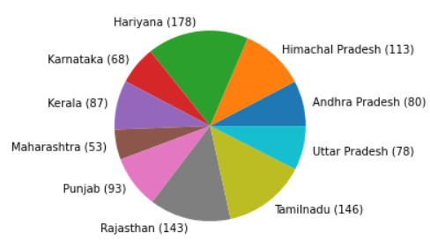
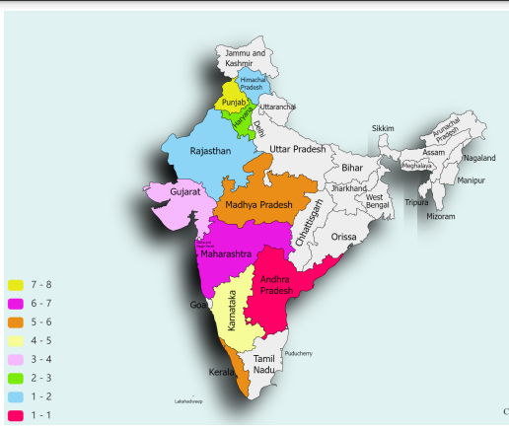
Correspondence ANALYSIS

Slide 17
CORRESPONDENCE ANALYSIS of all fuels & states
Interpretation :- From above plots we can see that petrol & Diesel are highly used in all states but CNG & EV need to be get more aware among population of respective states.

Slide 18
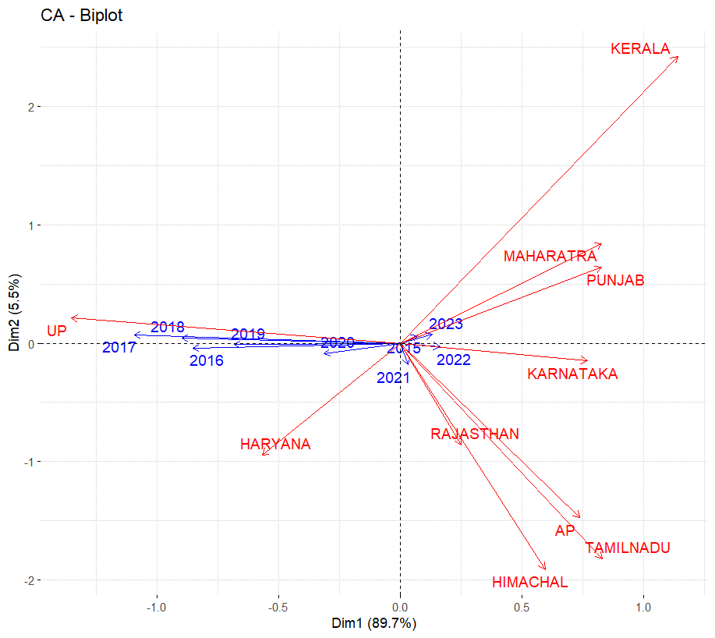
CORRESPONDENCE ANALYSIS OF ONLY EV:-
INTERPRETATION:- From above plot we can see that Maharastra, Punjab, Karnataka, Haryana & UP have good number of Electronic Vehicles . But we need to spread awareness about EV in Andhra Pradesh, Himachal Pradesh &
Tamilnadu

Slide 19
CONCLUSION
According to data study it is observed that –
1)Highly used vehicle category is 2 wheeler in which petrol is highly used. while, Diesel is mostly used in other vehicle categories.
2) Electric vehicle is Future of India. Electric Vehicle will mostly be used in Future.
3) As Diesel and Petrol are our traditional fuels it will not be easy for Electric vehicle to increased its count than these fuels.
4)According to clustering, Andhra Pradesh , Himachal Pradesh, Punjab and Haryana are the states in which awareness of Electric Vehicle should be increased.

Slide 20
LIMITATIONS
1)Due to Corona pandemic their was high decreased in number of all vehicles which has affected our forecasting.
2)Due to small amount of data of Electric Vehicles, its large prediction was not possible.

Slide 21
THANK YOU!

